Slide 1
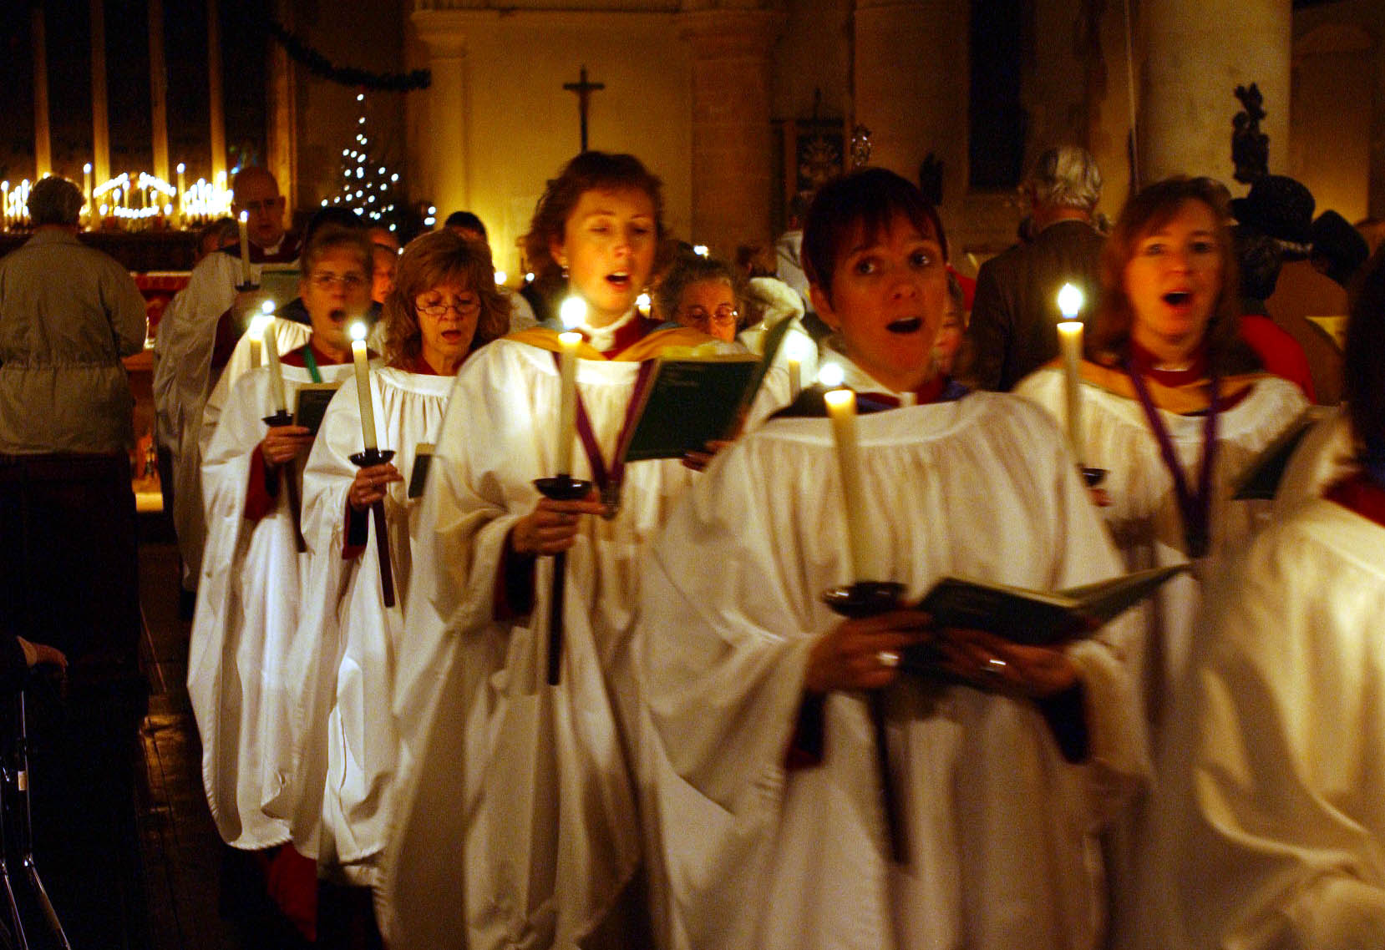
THE MASS

Slide 2
In the Renaissance era the Mass was a sacred unaccompanied choral work using the five main sections of the Roman Catholic church liturgy.

Slide 3
Features of the Mass include Latin text and polyphonic texture. Originally unaccompanied, but in later years became a large-scale work for chorus, soloists
and orchestra.

Slide 4
The style of the composition changed over hundreds of years (like the addition of an orchestra) but the text remains the same, no matter what period it was composed in.

Slide 5
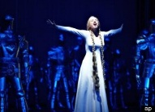
Be careful not to confuse the Mass with an Oratorio or Opera!
The trick is to listen very closely to the words being sung.
If you hear operatic singing mostly religious words such as Amen, Messiah, Hallelujah etc the piece is likely to be an Oratorio.
If you hear operatic singing in Italian
or German but NO recognisable
religious words, the piece is likely to
be from an Opera.

Slide 6
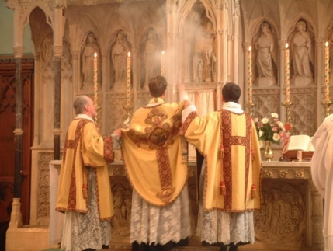
The Mass is sung in Latin and there are certain words to listen out for…

Slide 7
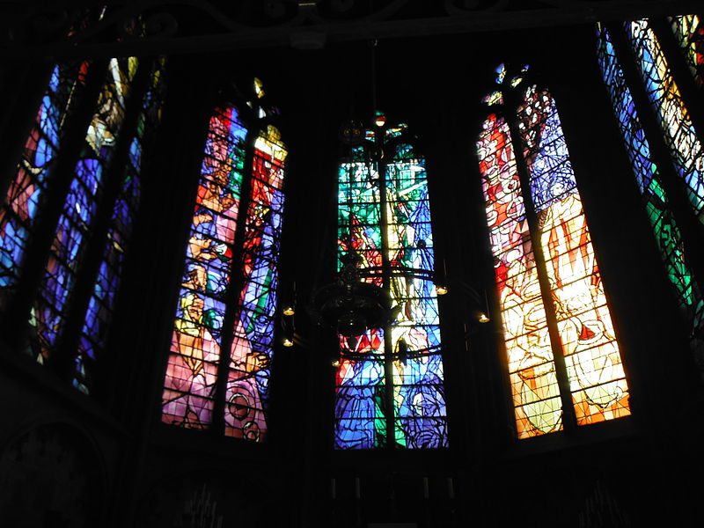
Kyrie eleison
("Lord, have mercy")
This example is from the Baroque (Bach)

Slide 8
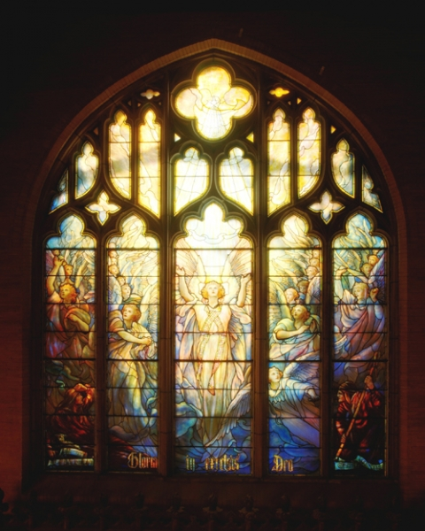
Gloria
("Glory to God in the highest")
This example is from the Romantic Period (Schubert)

Slide 9
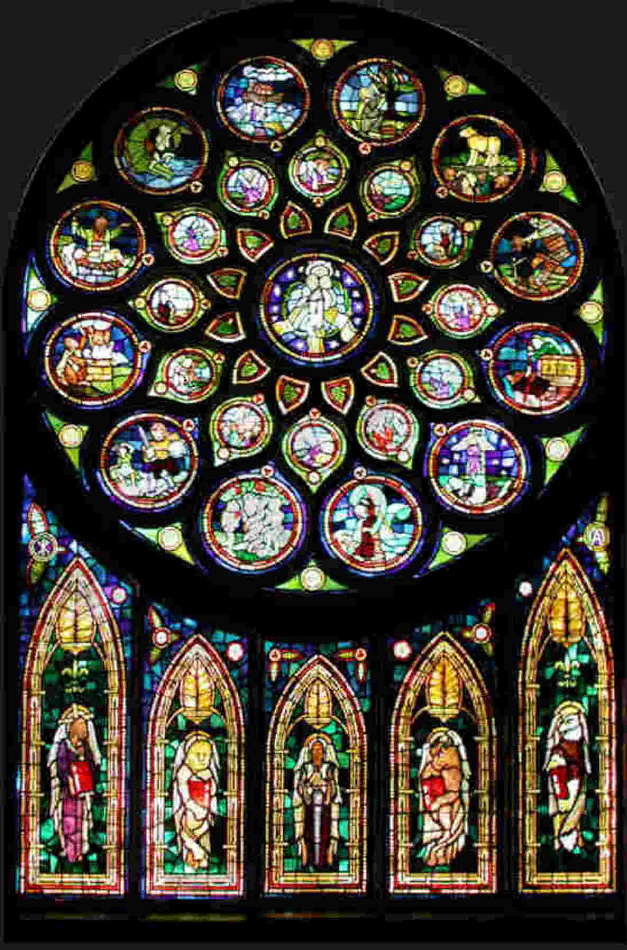
Credo
("I believe in one God")
Example from the Classical period (Beethoven)

Slide 10
Sanctus and Benedictus
Begins with Sanctus, Sanctus, Sanctus (Holy, holy, holy Lord God of Hosts)
The Benedictus (Blessed is He..) is a continuation of the Sanctus.
Example from the 20th Century (Rutter)

Slide 11
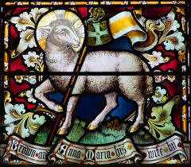
Agnus Dei
(Lamb of God)
Example from the Renaissance Period (Byrd)

Slide 12
Can you tell the difference between an Oratorio, an Opera and a Mass?
Oratorio, Opera or Mass?
Oratorio, Opera or Mass?
Oratorio, Opera or Mass?
Oratorio, Opera or Mass?
Oratorio, Opera or Mass?

