Slide 1
Serialism
Higher/Advanced Higher Music
Composition

Slide 2
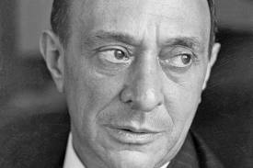
Schoenberg
Arnold Schoenberg was born in Vienna in 1874. He was a Professor of Composition in Berlin and later Los Angeles. He was a gifted composer, teacher and painter.
Schoenberg, together with two of his pupils, Berg and Webern, are known as the Second Viennese School (‘school’ here means a group of people whose work shares a common style).
The First Viennese School refers to Mozart, Haydn and Beethoven.
Schoenberg’s first compositions were Romantic in style eg ‘Transfigured Night’. His style of composition later changed.
Transfigured Night

Slide 3
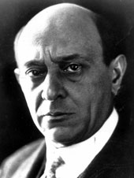
Expressionism
His music became increasingly dissonant and chromatic in the style of Expressionism.
Expressionism – for the composer, the expression of emotion and state of mind was of complete importance over any form or structure in the music.
It was also a term that was applied to the visual arts, to the work of painters such as Kandinsky, Klee and Munch (The Scream – possibly the most well-known expressionist painting, with an obvious link to Schoenberg’s Erwartung.)
Excerpt from Schoenberg’s ‘Erwartung’

Slide 4
The move to serialism
The sense of key became less and less obvious eventually resulting in atonality.
Audiences and critics found Schoenberg’s atonal music difficult to understand. There was so much unrest at one concert that the police were called.
Totally free expression, with no form or tonal boundaries was all well and good but the movement was clearly limited.
As he worked through his expressionist period, Schoenberg realised that music needed a new means of defining form and structure, which would also embrace the atonally chromatic musical language.
The solution came in his serial composition techniques, which he first used in the Five Pieces for Piano Op. 23, the Serenade Op. 24 and the Suite for Piano Op. 25.
Serenade Op.24

Slide 5
HOMEWORK TASK
Create a 1 page fact sheet on ARNOLD SCHOENBERG.
You should include the following information:
Background of his life – born, died, jobs, musician friends, where he spent his life, other styles of music he composed etc.
Why he wrote pieces using a SERIAL approach
2 examples of his serial music – listen to them, comment on what you hear and find out some information about the pieces
DUE 1 WEEK FROM TODAY
****FORMS PART OF COMPOSITION ASSESSMENT****

Slide 6
What is serialism?
Serialism is a technique of composing in which one or more musical elements e.g. pitch, duration, dynamics, are arranged in a fixed specific order, or series.
The most common element to be arranged in a series is pitch, in which all twelve tones of the octave are arranged in an order the composer chooses.
This is called a TONE ROW.

Slide 7
Tone Row
A tone row is used both horizontally to construct melody lines and vertically to construct groupings of notes, or chords.
Serial composition technique involves using the tone row in four ways:
As the original row
Inverted (upside down)
Retrograde (backwards)
Retrograde Inversion (backwards and upside down)

Slide 8
Tone Row
There are a total of 12 different pitches:
Schoenberg’s theory of serial (or twelve tone) composition requires the composer to invent a series, or ‘tone row’.
The series is a melodic line that includes all twelve pitches in an order determined by the composer, but without repeating any of the pitches before the other eleven have been sounded.

Slide 9
Tone Row
For example, the series that Schoenberg used as the basis of the third of his Op. 48 song is:
As you can see, each pitch has only been used once.
This is called the ‘PRIME’ series.
Once the tone row has been formed, as shown above, it is then possible to derive three further variations of the series, namely:

Slide 10
RETROGRADE
The RETROGRADE is simply the original row played backwards starting with the last note and ending with the first.
PRIME
RETROGRADE

Slide 11
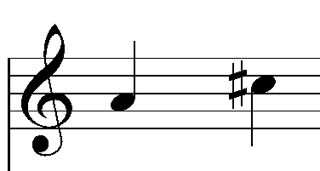
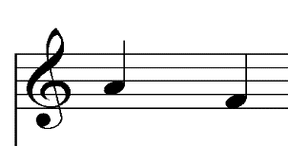
INVERSION
The INVERSION is produced by reversing the direction of the intervals in the original tone row.
For example:
A to C# - 4 semitones higher
Inverted becomes
A to F – 4 semitones lower
PRIME
INVERTED

Slide 12
RETROGRADE INVERSION
The RETROGRADE INVERSION is simply the inversion played backwards!
PRIME
INVERSION
RETROGRADE INVERSION

Slide 13
Further Rows
So the composer has four basic melodic lines to work with –
PRIME (P)
INVERSION (I)
RETROGRADE (R)
RETROGRADE INVERSION (RI)
But he can go further – in the same way that tonal music can modulate to other keys, each version of the tone row can be played starting on each of the 12 notes of the chromatic scale.

Slide 14
Transposing
The original row, in it’s PRIME version, starts on C#:
It can then be transposed to start on D:
It is still the same tone row, with the same pattern of intervals, it is only the starting note that is different.
This version of the tone row is called Prime 1 (P1), played one semitone higher than the original PRIME version of the tone row.

Slide 15
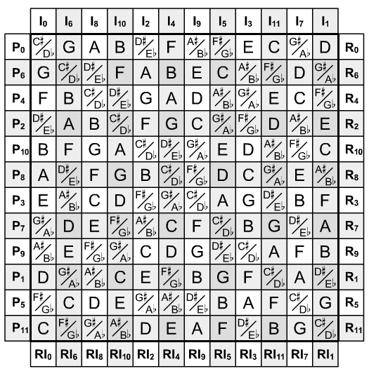
Tone Rows
Taking this process to its full conclusion, and applying it to the prime, retrograde, inversion and retrograde inversion of the tone row, you then have a possible 48 versions of the tone row to work with in a composition.

Slide 16
Serial Music
All of this might seem incredibly mathematical, but in reality the application of the Twelve Tone Theory by Schoenberg and his pupils Alban Berg and Anton Webern produced some haunting and extremely expressive music.
Berg, took a lyrical approach to serial composition and many of his tone rows are constructed in a way that includes tonal triads (major or minor chords)
Schoenberg explored a technique where he gave individual notes of a tone row to different instrumental timbres, creating a kaleidoscope of sound (rather than the row being played in its entirety by one instrument).

Slide 17
Schoenberg: Trio from Suite fur Klavier Op. 25
Schoenberg composed his Piano Suite Op. 25 in 1924, and it was first published the following year.
It is a noteworthy work for two reasons.
Firstly, it is a good example of an early twentieth century composer using forms from the past to shape and structure his own, original compositions – NEO CLASSICISM. Although he uses a Baroque dance suite as his model.
Secondly, this suite is one of the first compositions in which Schoenberg employed the serial (twelve tone) approach to composition.

Slide 18
Schoenberg: Trio from Suite fur Klavier Op. 25
This example is probably the most straightforward and easiest to understand of all Schoenberg’s serial compositions and is therefore an excellent starting point for your study of serial music.
Listen to the excerpt before looking at it in more detail.

Slide 19
Schoenberg: Trio from Suite fur Klavier Op. 25

Slide 20
Your Opinion Counts…
What do you think of that piece of music?
Does it make you think of anything in particular?
What do you notice about the dynamics?
What do you notice about the rhythm?
What different expression marks are used?
Did you enjoy it?

Slide 21
Form
The extract given here is the trio section from longer MINUET & TRIO movement.
In the Baroque/Classical tradition, the movement runs in a ‘minuet-trio-minuet’ from.

Slide 22
The Tone Row
The trio is constructed using a tone row heard in the left-hand line of bars 1-2:
The tone row has been constructed very carefully:
Stepwise motif - Notes 1 - 3
Interval of a perfect 4th - Notes 4 – 5 and 6 - 7
Interval of a tritone - Notes 3 – 4 and 7 – 8
Interval of a semitone - Notes 9 – 10 and 11 - 12

Slide 23
The Tone Row
So, in its basic form, the tone row has its own distinctive character.
When Schoenberg announces the series for the first time in the trio, he adds even more character by expanding or inverting some of the intervals and giving the row a quirky rhythm, enhanced by carefully placed articulation and dynamics.

Slide 24
Tone Rows
In the second bar, the right hand enters with an inverted, transposed version of the tone row:
Rather than starting on E, the transposed row starts on Bb (6 semitones higher).
If the original row is called P0, then this new version is the inverted version starting 6 semitones higher than the original – I6.

Slide 25
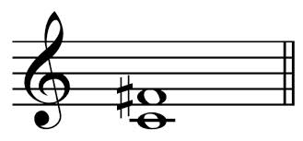
Tritone
You should notice that the interval between E and Bb – the starting notes for these two versions of the tone row – is a tritone, one of the key intervals within the original tone row.
TRITONE – A musical interval composed of three whole tones
It will not surprise you to hear that the TRITONE was banned in Renaissance church music!
It is known widely as the ‘Devil’s Chord’ and is one of the most dissonant intervals around.
It was considered unpleasant and ugly, and was named "diabolus in musica" - "the devil in music“.

Slide 26
Tone Rows
Having finished playing the original tone row through once, in bar 3 the left hand plays the inverted version of the tone row, exactly imitating the line started by the right hand in bar 2.
Row 2 – I6
Row 1 - PO
Row 3 - IO

Slide 27
Your turn
You have been given information on the first 3 rows.
Using your own copy of the score, use coloured pens to annotate your score, identifying the different rows being used.
Look at dynamics, articulation, tempo markings etc.
Here is a graph illustrating the first five bars:

Slide 28
Analysis of a score
You are now going to analyse a short piece of music by Witold Lutoslawski.
Listen carefully to the recording of this piece and then answer the questions on your worksheet.

Slide 29
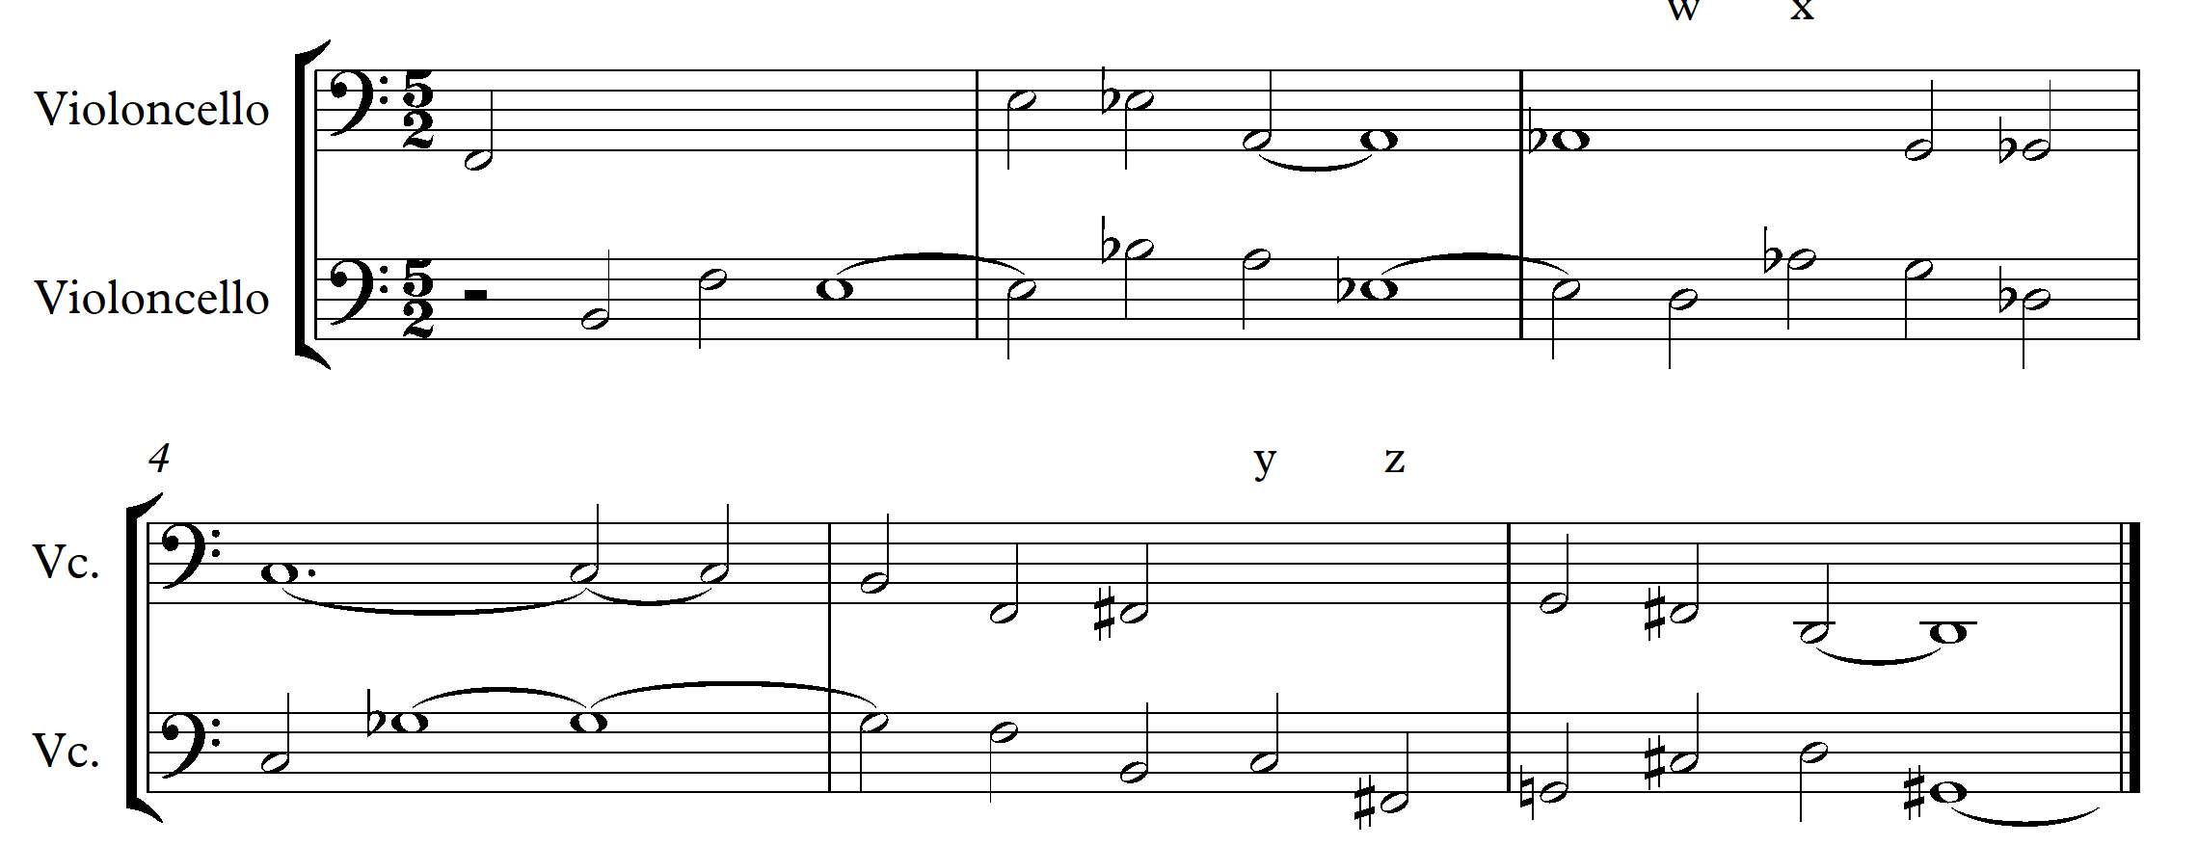
Muzyka Zalobna (Funeral Music) by Witold Lutoslawski

Slide 30
Muzyka Zalobna (Funeral Music) by Witold Lutoslawski
In bar 1, only the first cello 1 note is given. On the score, complete this bar, giving both the correct rhythm and pitches.
There are two important intervals used to construct the horizontal lines of this piece. What are those intervals?
Describe the intervals formed by the notes played by the two cellos at points ‘w’, ‘x’, ‘y’ and ‘z’ on the score.
Which type of scale is used to construct this music?
Pentatonic Modal Minor Whole Tone Twelve tone
How is the texture of this music constructed? Use your answer to question 3 to help you, together with any other appropriate technical terms or devices.
In which twentieth century compositional style is this piece composed?

Slide 31
Muzyka Zalobna

Slide 32
What do you think?
Is serialism music?
Is there any creativity involved in composing a 12 tone row?

Slide 33
What concepts can you use?
Think back over the two pieces of music you have analysed.
Which concepts would you like to use in your composition?
Are there any more concepts not mentioned so far that you would also like to include?
Take a note of your ideas at this stage.

Slide 34
What concepts can you use?
Concepts from pieces we listened to: | Other concepts I would like to use:
Any other ideas (instrumentation, rhythms, harmony):

Slide 35
Reflection
Reflect on what you have learned so far. You should cover:
What you have done successfully
Anything that you are unsure of
What you plan to do next
How you will use what you have learned to write your own composition

Slide 36
Constructing your Tone Row
Before constructing your tone row, consider the character of serial music you want to write.
A tone row can be constructed with a tonal basis through planning the order of the notes to fall into groups of tonality based harmonies.
For example, Berg’s Violin Concerto is a very warm, expressive work based on a tonally conceived row as can be seen below..
E major
D major
G minor
A Minor
Whole Tone Scale

Slide 37
Constructing your Tone Row
Berg generally used tone rows in a freer manner than Shoenberg or Webern, not always following exactly the order of the row.
His music combines serial techniques with rich harmonies – made up from groupings of notes from his tonally designed row – with a lyrical quality, which makes his music attractive and immediately appealing.
Whereas Berg preferred a lyrical approach to his rows, Webern’s rows and his textures are characterised by a strident, angular style. Webern was also interested in the possibilities of symmetrical relationships within the tone row, as we shall see.

Slide 38
Concerto for Nine Instruments – Tone Row
Here is Webern’s tone row in his Concerto for Nine Instruments:
We can consider this as a group of four trichords.
Call the first one the prime trichord.
Then the second is its retrograde inversion,
the third is its retrograde,
and the fourth is its inversion
(again, freely transposing as necessary).
The symmetries created by this give the piece a very cool, formal feel.

Slide 39
Symphony Op. 21
In Webern’s Symphony Op. 21 the row is as follows:
Firstly, the interval between the 1st and 12th, 2nd and 11th, etc. notes of the row is always a TRITONE;

Slide 40
Symphony Op. 21
Secondly, there is a symmetrical pattern of semitones within the tone row:
Thirdly, the second half of the tone row (notes 7-12) is the retrograde of the first half (notes 1-6), transposed by a tritone;
This gives you some idea of the complex detail that composers undertook in their compositional process.

Slide 41
Your Turn…
1. Decide on the style of your piece….
Ideas box
Use some of these points to help you decide on your style: Decide on a title Decide on a theme – horror/mysterious/dark etc Are you going to base it on an earlier structure like minuet & trio? - Neoclassicism Programmatic – descriptive music based on a theme

Slide 42
Your Turn…
Title of piece
Theme
Structure
Descriptive

Slide 43
Your Turn…
2. Now spend some time considering how you are going to structure your own tone row. Use the space below to record the steps you took when writing your row.

Slide 44
Write your tone row in the stave below:
Now work out the RETROGRADE version of your row:
Now work out the INVERSION of your row:
Now work out the RETROGRADE INVERSION of your row:

Slide 45
Add your PRIME row to the top line of the matrix below:
 | I0 | I | I | I | I | I | I | I | I | I | I | I
P0 |  |  |  |  |  |  |  |  |  |  |  |  | R0
P |  |  |  |  |  |  |  |  |  |  |  |  | R
P |  |  |  |  |  |  |  |  |  |  |  |  | R
P |  |  |  |  |  |  |  |  |  |  |  |  | R
P |  |  |  |  |  |  |  |  |  |  |  |  | R
P |  |  |  |  |  |  |  |  |  |  |  |  | R
P |  |  |  |  |  |  |  |  |  |  |  |  | R
P |  |  |  |  |  |  |  |  |  |  |  |  | R
P |  |  |  |  |  |  |  |  |  |  |  |  | R
P |  |  |  |  |  |  |  |  |  |  |  |  | R
P |  |  |  |  |  |  |  |  |  |  |  |  | R
P |  |  |  |  |  |  |  |  |  |  |  |  | R
 | RI0 | RI | RI | RI | RI | RI | RI | RI | RI | RI | RI | RI

Slide 46
The layout of your row will affect where in the table your other rows begin.
For example, if I used Berg’s row:
I would write my PRIME row in the top line and then work out my PRIME INVERSION which would go into the left hand column.
P0 starts on G so P1 will start on G# and P2 will start on A and so on…

Slide 47
 | I0 | I3 | I7 | I11 | I2 | I5 | I9 | I1 | I4 | I6 | I8 | I10
P0 | G | Bb | D | F# | A | C | E | G# | B | C# | Eb | F | R0
P9 | E |  |  |  |  |  |  |  |  |  |  |  | R9
P5 | C |  |  |  |  |  |  |  |  |  |  |  | R5
P1 | G# | B | D# | G | Bb | C# | F | A | C | D | E | F# | R1
P10 | F |  |  |  |  |  |  |  |  |  |  |  | R10
P7 | D |  |  |  |  |  |  |  |  |  |  |  | R7
P3 | Bb |  |  |  |  |  |  |  |  |  |  |  | R3
P11 | F# |  |  |  |  |  |  |  |  |  |  |  | R11
P8 | Eb |  |  |  |  |  |  |  |  |  |  |  | R8
P6 | C# |  |  |  |  |  |  |  |  |  |  |  | R6
P4 | B |  |  |  |  |  |  |  |  |  |  |  | R4
P2 | A |  |  |  |  |  |  |  |  |  |  |  | R2
 | RI0 | RI3 | RI7 | RI11 | RI2 | RI5 | RI9 | RI1 | RI4 | RI6 | RI8 | RI10

Slide 48
Add numbers to the PRIME column following this pattern.
Then add numbers to the RETROGRADE column (same as the PRIME)
Add numbers to the INVERSION – this starts on the same note as the PRIME.
Add numbers to the RETROGRADE INVERSION – same as inversion
Now complete the PRIME ROWS starting with P1 and move every note in P0 up a semitone. Then with P2 move every note in P1 up a semitone, and so on.
You should now have a completed matrix with all 48 possible rows that you can use.

Slide 49
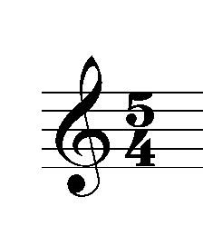
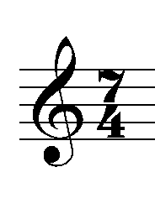
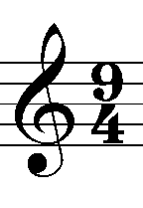
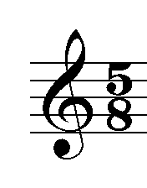
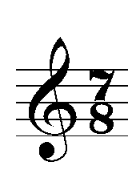
Rhythm
In serial music, rhythmic patterns:
Are often complex
Have regularly changing metres
Contain irregular accents, pulses or dividing parts of beats
Time signatures are often unusual and can change regularly. Some Time Signatures that are often found in serial music are:
Choose at least one Time Signature you think would be appropriate for your piece of music.

Slide 50
Before you start composing your piece, decide on a few rhythms you could use within the time signature you have chosen. There are some examples below.
Notice the use of rests, accents, staccato and slurs.

Slide 51
Time Signature/Rhythm
Now, using the time signature you have chosen, create 4 rhythms in the boxes below. This can be used as a basis for your piece.
Remember to include ARTICULATION (staccato/slur/accents)

Slide 52
Augmentation
Two rhythmic devices often used in SERIAL music are:
AUGMENTATION - An increase in the length of notes. The music will sound slower when imitated or repeated.
For example:
This: will become

Slide 53
Diminution
DIMINUTION - A decrease in the length of notes. The music will sound faster when imitated or repeated.
For example:
This: will become

Slide 54
Augmentation
Choose 2 examples from your rhythms above and AUGMENT them..

Slide 55
Diminution
Using the remaining two rows, write them out below using DIMINUTION..
Try to use both of these concepts within your piece.

Slide 56
Writing a melody
Decide on one row from your matrix -
Using a rhythmic idea above, create a melody in the space below:
Show this to your teacher when you have finished.

Slide 57
TEXTURE
There are three types of texture that you can base your piece of music on:
Imitative Counterpoint – where a row is repeated in another instrument and so on, similar to Schoenberg’s Trio from Suite fur Klavier Op. 25, which we looked at earlier in the unit.

Slide 58
TEXTURE
Harmonic Texture – where the rows are used to create harmony. You may use one row to create a melodic line and another row in clusters to create a harmonic accompaniment.
Pointillism – where passages of music where the notes tend to be dots, rather than rounded musical phrases. In music, pointillism texture is extremely bare and sparse and made up of single notes, tiny motifs or wisps of sound.

Slide 59
TEXTURE
Consider each of these options and make notes below describing which style you feel would be most appropriate to your piece and why.

Slide 60
STYLE
If you want to introduce NEOCLASSICISM to your piece by choosing an earlier structure as a basis, then you will have to find out more information relating to that structure.
For example, you may choose to write in the style of a Minuet & Trio. If this is something you are considering, take time to fully research the style and make notes on your worksheet.

Slide 61
TIMBRE
You have probably considered your instrumental choice already, but remember to consider the following factors:
Do not choose too many instruments!
Consider the style/theme of your piece
If you are writing in a NEO-CLASSICAL style, you should consider the instruments used at that time

Slide 62
TIMBRE
Instruments in my piece are…

Slide 63
You are going to analyse an example of work found over the page. Comment on the following:
Tone Rows
Articulation
Dynamics
Time signature
Any other comments

Slide 64
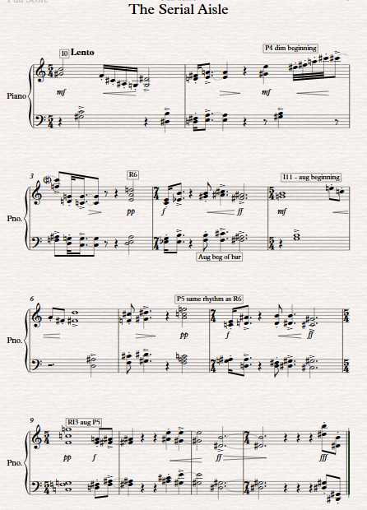

Slide 65
Now it’s your turn!
Using the ideas in this booklet, go to a computer with Sibelius and begin to write your piece!

