Slide 1
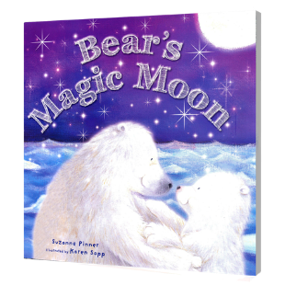
Music Technology Project
Abbiegayle Boyle
Audiobook PROJECT
Little Polar Bear’s Magic Moon
CANDIDATE NO -090827774

Slide 2
Planning decisions
I choose to do an audio book as I liked the idea of a children's books. I also knew that I can put in a lot of SFX and Foley as the children's books are quite descriptive and they have simplistic words and plots and that would be better for me as I struggle with speaking and saying certain words but a children's book wouldn’t have the language that other books have so I will hopefully be able to read it with little to no trouble. I chose Little Polar Bears magic moon as I skimmed the book and saw the water and I knew I could have some good sound effects for that.

Slide 3
Planning - Synopsis
The story is about a young bear who is afraid of the dark. The story tells us about how this young bear lives her life and that she doesn’t like the dark. The book first describers her with her friends and it then tells us that she doesn’t like the dark. Then the book goes on and her dad tells her about the full moon celebration that all the bears are having. The young bear then goes home upset because she cant go. The oldest bear then helps her by telling her too look outside. She then does and sees the full moon. All the bears have a party and they are all happy.

Slide 4
Planning - Storyboard
Pages 1-3
Sound FX | Foley | Music
Anime sparkles sound Water splashing Chatter Fish swimming | Speech | Happy cheerful music Suspenseful music

Slide 5
Scene one script
Little Polar bear’s home is cold and snowy. The icebergs glimmer… the water sparkles … and Little Polar Bear plays with her friends all day long. She loves rolling in the crisp, white snow until her fur sparkles. She loves diving into the blue swirly water and chasing fish. There’s just one thing that little polar bear doesn’t like. The night is very, very… dark.

Slide 6
Planning - Storyboard
Pages 4-9
Sound FX | Foley | Music
Wind Sobbing Splashing Footsteps I the snow | Speech | Dramatic music Sad music

Slide 7
Scene two script
All the polar bears are gathering to welcome the full moon. Tonight is a very special night.
“Come with me, Little Polar Bear,” says dad. “It will be great fun. We will sing songs. We will dance until the sun rises over the icebergs.” “I’ll never be able to welcome the new moon,” says little polar bear. “I’m just not brave enough.” Big tears roll down her nose and plop onto the ice. Then, she hears a heavy paw-step, scrunching in the snow. Little polar bear is very scared! But it’s only the wise old bear! “Don’t cry, little polar bear,” he says “There’ nothing to be afraid of. Come outside and you will see something wonderful. “Little polar bear shivers and shakes but she goes outside with the wise old bear. Little polar bear is frightened. But slowly… … slowly… … slowly… … she looks up.

Slide 8
Planning - Storyboard
Pages 10-end
Sound FX | Foley | Music
Anime sparkles again Wind Water splashing Cheering | faint water sounds speech | Calm music Happy cheerful music

Slide 9
Scene three script
The round moon is full and bright. “It’s so beautiful.” Whispers little polar bear. “The moon and the stars are your friends,” Says the wise old bear “You can tell them all your secretes. They have watched over a; bears for hundreds of years and hundreds of years they will watch over you, too.” Little polar bear runs to meet dad. They jump and dive and play in the after. They sing and dance in the moon light. Dad gives Little Polar bear a big bear hug. “You did something very special,” He says. “You did something even though you were scared. Do you know what that makes you, little polar bear?”
“The bravest bear of all!”

Slide 10
Planning – Equipment List
Tascam recorder DR-05
PC
Phillips Headphones
Mixcraft
Condenser Microphone
XLR Lead
Boom Stand
Pop shield
Google

Slide 11
Planning – Foley sounds
To record the speech, I will use a condenser microphone and stand about 15-30 cm away from it with a pop shield in front of it. I will record the parts where the characters are speaking separately as I may want to add effects to those parts alone.
For the faint water sounds, I will use a Tascam recorder to record a radiator that sounds like its leaking and place the microphone bout 10 cm away as the sounds are quite quiet as is.

Slide 12
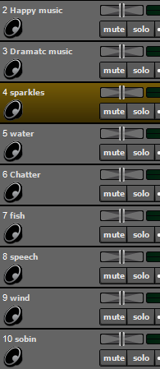
Planning – Set-up
I will save my work into a folder and save that folder centrally.
For my mixcraft project, I will save it into this folder. I will make a track for every sound I have said I need. I will set it to into scenes and colour code them accordingly.

Slide 13
Planning - Evaluation
What went well overall?
Overall, I feel planning went well as I got it completed quickly buy effectively. This leaves me more time to spend on implementing and making sure everything is in place. Although I completed it quickly, I feel confident that I will be able to implement it successfully having planned well.
What was challenging overall?
Overall, I found making sure I had everything completed difficult as I was doubting if I had everything in but I checked a few times and I had .
What would I do differently next time?
Next time I would make sure I know how to describe the book in detail as this time as I was confused about the plot.

Slide 14
Date 23/01
Today I have found all my SFX off of the internet and have them all in my folder for my sounds. I got these off of YouTube mainly and a sound effects website.
I found getting the correct sounding sounds difficult as I had an specific idea on what I wanted and it was hard to find the right sound or if I did find the right sound the quality wasn’t great and it wouldn’t sound right with the rest of my project.
I found finding certain sounds easier as they had more range and I knew exactly what to search to find them.
Tomorrow I plan to record the small sound effects I need to and start placing in some sfx into my mixcraft

Slide 15
Date – 24/01
Today I recorded my foley sounds and started to think about the music that I will have playing in the background.
I found recording my foley sounds difficult as I couldn’t find a quiet spot at first but I found it after searching for a small while.
I found planning the background music easy as I had a vague idea of what I wanted it to sound like.
Tomorrow I plan to start it make the background music as I didn’t have enough time in class to actually start it.

Slide 16
Date- 25/01
Today I have finished making my background music and started to put in all my SFX in scenes but not in place as I have yet to recorded my speech.
I found putting in my SFX difficult as I am unsure as to where they have to go. I also found making my background music difficult as I kept having new ideas on what I wanted it to sound more like and the I chose something else.
I found choosing the instrument the MIDI keyboard easy as the glockenspiel has a softer sound than most and it just seemed to fit well with the book I am doing.
Tomorrow I plan to record my speech so I can start to put my SFX and other recordings in place and then I should have more time to check over it.

Slide 17
Date- 28/01
Today I have recording all of my speech and I have it saved into my mixcraft, I also revisited my background music as after I had implemented my speech it didn’t seem to fit.
I found recording them difficult as I had to rerecord a few times as I kept stuttering and sometimes I would say the wrong word or start laughing. I got it done after a few tries.
I found setting up the microphone and my mixcraft easy as I knew how to set them both up as I had set them up before and I only needed to change and add a few things.
Tomorrow I plan to start to put the sound effects I have in the right places, and add any effects I need to so that they seem right.

Slide 18
Date- 13/02
Today I have started to sort out scene one so every thing is in the right lace and matches with what I am saying in my audio. I have also started to note what effects I might need to add but I will revisit this ad I am unsure.
I found putting the sounds in the right place difficult as I had to relisten to the speech and then add the sound and listen again.
I found it easy to make sure that I had all my sounds in my project as I could refer back to my diary if I forgot what I needed to do.
Tomorrow I plan to make a intro for my book and start to clean up scene one

Slide 19
Date- 15/02
owo
Today I have made an intro for my audio book and I have revisited my background music. I feel like both are okay now and I can focus on SFX now and not worry about the music
I found making sure the sound effects were in the right place difficult as I wasn’t sure on everything at first.
I found it easy to make the intro as it just seemed to just fit the first try, although it took a few tries to get the recording right as I made mistakes .
Tomorrow I plan to focus on the second scene and possibly recoding a small introduction for my book.

Slide 20
Date- 19/02
Today I have placed all my sounds in the right place for scene one and I started to do the same for scene 2.
I found it difficult to make sure the sound were in the right place and to make sure that they didn’t block out or cover the voiceover.
Tomorrow I plan to go over scene one one last time and then start to add in the sounds for scene two and, if all goes smoothly, I should be able to finish scene two and start to work on scene three.

Slide 21
Date- 20/02
Today I have added in most of the sound effects I need for scene three. I started by placing them roughly where I thought they should be without listening to the speech and the I started to listen to the speech and placing them
I found it difficult to put the sounds in the right place as I didn’t have a video or visual representation as to where the sounds should be.
I found it easy to insert the sounds roughly where they should be as I could roughly guess as I could go back to my script and guess where it was.
Tomorrow I plan to finish my project completely and then check it over again to make sure that I haven’t missed anything that I could add in.

Slide 22
Date- 26/02
Today I have finished the most part of my project.
I found it difficult to make sure I had added everything, kept my diary up to date and making sure my speech wasn’t too fast
I found it easy to reference my diary and make sure I had everything in place that I had planed to do and make sure every sound was in my project
Tomorrow I plan to record my intro tomorrow and hopefully

Slide 23
Date-1/03
Today I have fixed my background music and added in some extra sound effects I though would make it sound better as they just seemed to make the book sound better, in my head anyway.
I found finding these sound effects difficult as I hadn’t planned them and didn’t have a clue where too look but I found them after some small trial and error.
I found it easy to place these sound as after many tries and some practice from my other sound effects I got the jist of it and it only took me a few tries to get this right.
Tomorrow I plan to make sure everything is recorded and exactly as I want it

Slide 24
Implementing – Sound FX
I found most of my sound effect websites, like the BBC sound FX website and freesounds.org. However, there were some sound effects that I needed that these websites didn’t have so I looked on YouTube and after a lot of searching and checking, I found the sounds that I was looking for.
I made sure to save them into my folder before transferring them to mixcraft.
When importing them to my project, I made sure to zoom into the track and find the exact point where I wanted it to start.

Slide 25
Implementing - Music
I chose the background music as I felt it went well with the theme of the book. It also sounded quite childlike and was quite complementing to the story of the book.
I found the music on YouTube and I converted it to a MP3 and saved it into my central folder. I then imported it onto my mixcraft.
I wanted the story to be heard clearly, so the music sets the scene and then fades into the background when the voice starts, I used volume automation to do this.

Slide 26
Implementing - Foley
Speech; For the speech I used a condenser microphone( a AT2020, cardioid polar pattern) with a pop shield in front of it so I didn’t get popping & blasting in my recordings. I stood about 10cm away from the microphone. I had to record the first scene twice as I didn’t have good enough levels so I upped the gain and rerecorded and that sound better than what I had previously reordered.
Faint water sounds; For the faint water sounds I recorded this with a Tascam recorder (Omnidirectional polar pattern). I knew that the schools radiators gave off a small dripping and thought this would be a good sound for the book. I sat at the loudest part of the radiator and started to record holding the recorder around 3cm away from it. I was pretty happy with the way this sounded.

Slide 27
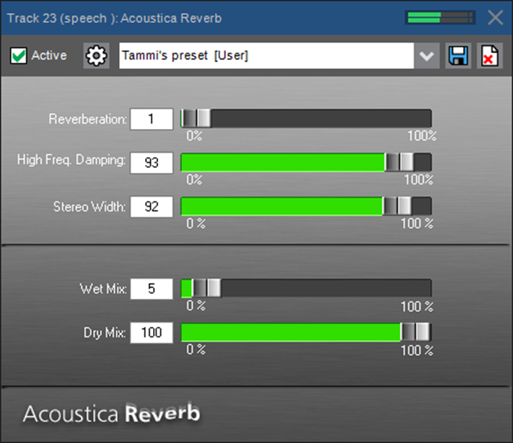
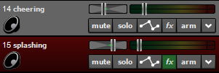
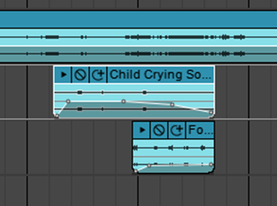
Implementing - Effects
Panning: I used panning when I had two sound effects going on at the same time as to differentiate them from each other. I also used panning automation for the footsteps in scene two as it makes it sound as if they are walking around the listener.
Reverb: I used reverb on all of my speech tracks as to make it sound as if it was recoded in a professional room and to give it ambiance. This also helped to make my voice a little clearer.
Volume automation; I used volume automation to ‘fade’ sound in and out so they didn’t just cut off suddenly. I also used it to make sounds sound louder at one point and the quieter.

Slide 28
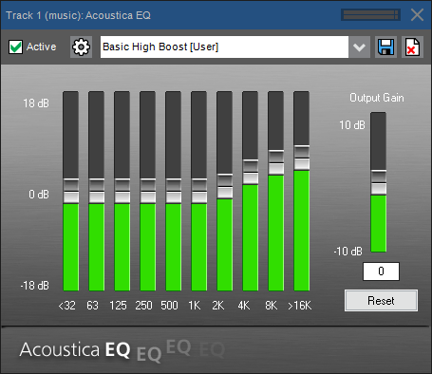
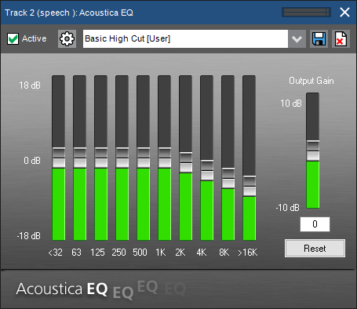
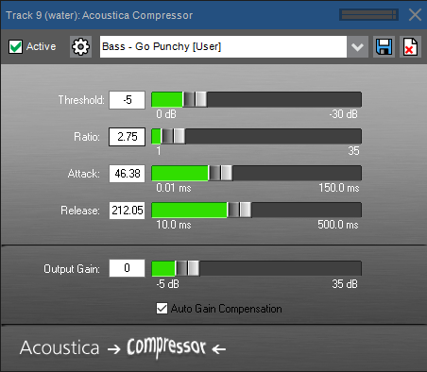
Implementing - Effects
EQ; I put EQ on a few different tracks as it helped in different ways. I used it on my background music to boost the high frequencies, and this gave it a more child like sound and this made it fit the theme of the book even more.
I also used EQ on the vocal tracks, as even though I used a pop shield, there was still sibilance present on the track, so I used the present ‘Basic High cut to eliminate this.
Compression; I used compression on a recording I it was quite quiet and not coming through in the mix. The compressor boosted it and helped it to mix better with the other sounds.

Slide 29
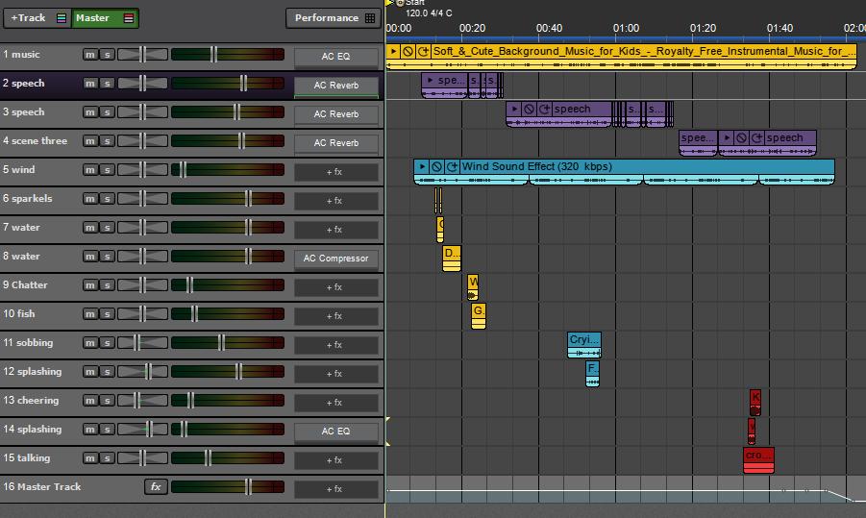
Here is a picture of my mix window. You can see my tracks have been labelled, my levels are good on individual recordings and I have colour coded tracks. My master track fades out at the end to provide an even finish.

Slide 30
Implementing – Bounce Down
When I was happy with my recording and had listened to it many times to get it just right, I decided it was time to bounce it down to a Stereo master mp3 file. I then saved the MP3 into my folder and listened to the track a number of times, to make sure I was completely happy with the sound.

Slide 31
Evaluation
I completed everything I wanted too and a few more things that I didn’t originally plan to. After I recorded my main speech, everything went well and it all just went from there. I found myself thinking about new sounds that I could use and that would make it better sounding.
I feel as if I could have kept my diary a little more up to date as I forgot to mention everything I did that day but I feel as if I kept it pretty up to date.
Overall, I feel as if the project went pretty well. I knew exactly what to do thanks to my plan, I knew where to get most of my sounds from past projects and I knew how to convert YouTube videos into Mp3’s and this made it easier to get sounds.

Slide 32
Evaluation
Overall, I feel as if the implementing stage was the hardest for me to complete as I didn’t have a visual representation of where to put the sounds this time and everything relied on the speech which I didn’t record until a few days in which was a bad choice as I wasted time that I could have used but that time also gave me time for recording foley ad getting SFX that I needed. I found it difficult to implement the SFX at the right time as I had to listen to the speech and the sound at the same time.

Slide 33
Evaluation
Next time, I would record my speech first rather than focus on the SFX and foley. If I had more time I would have seen if I could have found more places to put in sound effects in but I am happy with the amount of sound effects I have in as it doesn’t seem so over powering.

